Slide 1
Unit -One
Advanced Java

Slide 2
Swing Introduction
Swing is response to deficiencies present in Java's original GUI subsystem: Abstract Window Toolkit (AWT).
It is a part of the JFC (Java Foundation Classes), which is an API for providing a graphical user interface for Java programs.
Swing GUI components are completely resides in package javax.swing.
Although Swing eliminates a number of the limitations inherent in the AWT, Swing does not replace it. Instead, Swing is built on the foundation of the AWT.
Swing also uses the same event handling mechanism and Layout Managers as the AWT.

Slide 3
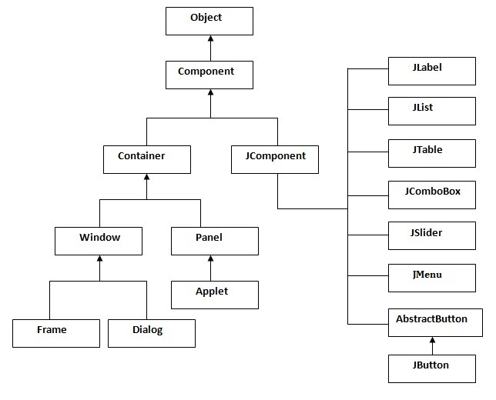
Swing Class Hierarchy

Slide 4
AWT vs Swing
Java AWT | Java Swing
AWT components are platform-dependent. | Swing components are platform-independent.
AWT components are heavyweight. | Swing components are lightweight.
AWT doesn't support pluggable look and feel. | Swing supports pluggable look and feel.
AWT provides fewer components than Swing. | Swing provides more powerful components .
AWT doesn't follows MVC. | Swing follows MVC.

Slide 5
Swing Components and Containers
Swing Components
Swing components are inherited from the javax.Swing.JComponent class, which is the root of the Swing component hierarchy.
JComponent provides the functionality that is common to all components. For example, JComponent supports the pluggable look and feel.
Examples of Swing components are JTextField, JLabel, JButton, JMenu etc.

Slide 6
Swing Components and Containers
Swing Containers
Swing defines two types of containers: heavy weight containers and light weight containers.
Heavy weight containers are top-level containers and are not inherited from JComponent rather they are directly inherited from AWT classes Component and Container.
Swing provides the following useful top-level containers: JWindow, JFrame, JDialog, and JApplet.
Lightweight containers are inherited from JComponent. An example of a lightweight container is Jpanel.

Slide 7
Creating GUI Using Swing
Create new class by extending top level container like JFrame
Create object of the class that inherits the container class
Set its title, size, layout etc
Add needed components in the container.
Make the container object visible at last
Example

Slide 8
Basic Swing Controls
JLabel
JLabel();//Creates label with no text and no image
JLabel(String text); //Create label with specified text
JLabel(Icon icn); //Creates label with specified icon
JLabel(String text, int alignment); //Creates label with specified text and alignment
JLabel(Icon icn, int alignment); //Creates label with specified icon and alignment
JLabel(String text,Icon icn, int alignment); //Creates label with specified text, icon and alignment

Slide 9
Basic Swing Controls
JTextField
JTextField(); //creates new text field without any initial text
JTextField(int col); //creates new text field having specified number of columns and with no initial text
JTextField(String text) ; //creates new text field having specified initial text
JTextField(String text, int col); //creates new text field having specified number of columns and initial text

Slide 10
Basic Swing Controls
JTextArea
JTextArea(); //create text area with default settings
JTextArea(int row, int col); //creates text area with specified number of rows and columns
JTextArea(String text); //creates text area with specified initial text
JTextArea(String text, int row,int col); //creates text area with specified number of rows, columns and initial text

Slide 11
Basic Swing Controls
JPasswordField
JPasswordField( ); //creates new text field without any initial text
JPasswordField(int col); //creates new text field having specified number of columns and with no initial text
JPasswordField(String text); //creates new text field having specified initial text
JPasswordField(String text, int col); //creates new text field having specified number of columns and initial text

Slide 12
Basic Swing Controls
JCheckBox
JCheckBox(); //create a check box with no label
JCheckBox(String text); //creates a check box with specified label
JCheckBox(String text, boolean state); //creates check box with specified label and state
JCheckBox(Icon icn); //creates check box with specified image icon
JCheckBox(Icon icn, boolean state); //creates check box with specified image icon and state
JCheckBox(String text, Icon icn); //creates check box with specified image icon and label
JCheckBox(String text, Icon icn, boolean state); //creates check box with specified image icon, label, and state

Slide 13
Basic Swing Controls
JRadioButton
JRadioButton();//creates a radio button with no label
JRadioButton(String text); //creates a radio button with specified label
JRadioButton(String text, boolean state); //creates radio button with specified label and state
JRadioButton(Icon icn); //creates radio button with specified image icon
JRadioButton(Icon icn, boolean state); //creates check box with specified image icon and state
JRadioButton(String text, Icon icn); //creates radio button with specified image icon and label
JRadioButton(String text, Icon icn,boolean state); //creates radio button with specified image icon, label, and state;

Slide 14
Basic Swing Controls
JButton
JButton();//creates a button with no label
JButton(String text); //creates a button with specified label
JButton(Icon icn); //creates button with specified image icon
JButton(String text, Icon icn); //creates button with specified image icon and label

Slide 15
Basic Swing Controls
JComboBox
JComboBox(); //creates combo box with no items
JComboBox(Object[ ] items); //creates combo box that contains items in specified object array
JComboBox(Vector items); //creates combo box that contains items in specified vector
Once an object of JComboBox class is created, we can add items into it by using addItem(String) method.

Slide 16
Basic Swing Controls
JList
JList(); //creates list with no items
JList(Object[ ] items); //creates list that contains items in specified object array
JList(Vector items); //creates list that contains items in specified vector

Slide 17
Basic Swing Controls
Example

Slide 18
Layout Managers
A layout manager automatically arranges controls within a window by using some type of algorithm. The layout manager is set by the setLayout() method.
Some of the most commonly used layout managers of java are:
Flow Layout
Border Layout
Grid Layout etc.

Slide 19
Layout Managers
Flow Layout
It is the default layout manager for the container Panel and Applets.
Components are laid out from the upper left corner, left to right, and top to bottom. When no more components fit on a line, the next one appears on the next line.
Commonly used Constructors
FlowLayout()
FlowLayout(int alignment)
FlowLayout(int alignment, int horz_gap, int vert_gap);

Slide 20
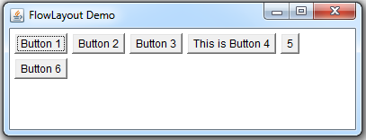
Layout Managers
Flow Layout
Example
Output

Slide 21
Layout Managers
Border Layout
The BorderLayout is used to arrange the components in five regions: north, south, east, west and center.
Each region (area) may contain one component only. It is the default layout of frame or window.
Commonly used Constructors
BorderLayout()
BorderLayout(int horz_gap, int vert_gap);

Slide 22
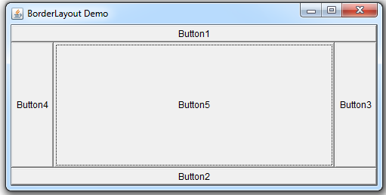
Layout Managers
Border Layout
Example
Output

Slide 23
Layout Managers
Grid Layout
It arranges components in a two-dimensional grid. It simply makes a bunch of components equal in size and displays them in the requested number of rows and columns.
Commonly used Constructors
GridLayout()
GridLayout(int row, int col);
BorderLayout(int row, int col, int horz_gap, int vert_gap);

Slide 24
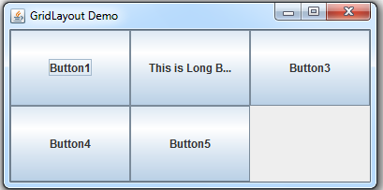
Layout Managers
Grid Layout
Example
Output

Slide 25
Layout Managers
Exercise
Write a Java Program to Create following UI
User ID
Password
OK
Calcel

Slide 26
Layout Managers
No Layout Managers
It is possible to arrange components in containers without a layout manager. In this case, items must be manually positioned and arranged. This layout should only be used if the window will not and cannot be resized, as the item in the window will stay where they are placed.
Creating a container without a layout manager involves the following steps.
Set the container's layout manager to null by calling setLayout(null).
Call the setBounds() method of Component class for each of the containers children to specify the position where the component should be placed.

Slide 27
Swing Menu
To create menus, we need to follow following steps:
First, A JMenubar is created
Then, we attach all of the menus to this JMenubar.
Then we add JMenuItem to the JMenu.
The JMenubar is then added to the frame by using setJMenuBar() method.

Slide 28
Swing Menu
JMenuBar
We can create menu bar by using following constructor:
JMenuBar()
JMenu
It can be created by using following constructors:
JMenu()
JMenu(String)

Slide 29
Swing Menu
JMenuItem
It can be created by using following constructors:
JMenuItem()
JMenuItem(String text)
JMenuItem(Icon icn)
JMenuItem(String text, Icon icn)
JMenuItem(String text, int mnemonic)

Slide 30
Swing Menu
JCheckBoxMenuItem
It can be created by using following constructors:
JCheckBoxMenuItem()
JCheckBoxMenuItem(String text)
JCheckBoxMenuItem(Icon icn)
JCheckBoxMenuItem(String text, boolean state)
JCheckBoxMenuItem(String text, Icon icn)
JCheckBoxMenuItem(String text, Icon icn, boolean state)

Slide 31
Swing Menu
JRadioButtonMenuItem
It can be created by using following constructors:
JRadioButtonMenuItem()
JRadioButtonMenuItem(String text)
JRadioButtonMenuItem(Icon icn)
JRadionButtonMenuItem(String text, boolean state)
JRadioButtonMenuItem(Icon icn, boolean state)
JRadionButtonMenuItem(String text, Icon icn)
JRadionButtonMenuItem(String text, Icon icn, boolean state)

Slide 32
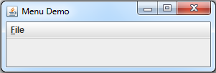
Swing Menu
Setting Mnemonics, Accelerator and Tooltip Text
We can specify mnemonic for menus and menu items by using setMnemonic() method as below:
JMenu filemenu= new JMenu(“File”);
Filemenu.setMnemonic(‘F’);

Slide 33
Creating Dialog Box
A Dialog window is an independent sub-window that is used to carry temporary notice apart from the main Swing Application Window.
To create simple, standard dialogs, we use the JOptionPane class.
Besides this, we can also create dialog box by using JDialog class.
A Dialog can be model or non-model.

Slide 34
Creating Dialog Box
Creating Dialog Box by using JOptionPane
Using JOptionPane, you can quickly create and customize several different kinds of dialogs.
Confirm Dialog
JOptionPane.showConfirmDialog(frame,”Do You Want to Exit?”, “Alert”, JOptionPane.YES_NO_CANCEL_OPTION)
Message Dialog
JOptionPane.showMessageDialog(frame,”Supply all required values”, “Not Empty”, JOptionPane.INFORMATION_MESSAGE)
Input Dialog
String num=JOptionPane.showInputDialog(frame,”Enter any Number”, “Input”)

Slide 35
Creating Dialog Box
Creating Dialog Box by using JDialog
JDialog class is foundation for all dialog boxes customized in swing. We can create dialog boxes by using any one of following constructor defined in JDialog class.
JDialog()
JDialog(parent_frame)
JDialog(parent_frame, modal)
JDialog(parent_frame, title)
JDialog(parent_frame, title, modal)
Example

Slide 36
Internal Frames
A JInternalFrame is a container that looks much like a JFrame. The key difference is that internal frames can only exist within some other Java container.
Thus, we must add an internal frame to a container (usually a JDesktopPane). The following list summarizes the rules for using internal frames.
Set size of internal frames
Set location
Add internal frames into DesktopPane
Call setVisible method
We can create internal frames by using any one of following constructors.
JInternalFrame()
JInternalFrame(String title, boolean resizable, boolean closeable, boolean maximizable, boolean iconifiable )

Slide 37
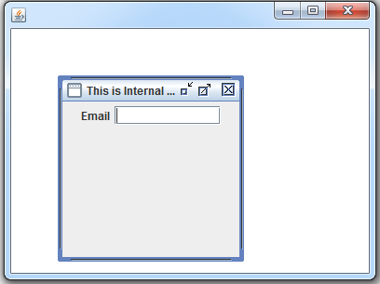
Internal Frames
Example

Slide 38
What is Event Handling
Event Handling is the mechanism that controls the event and decides what should happen if an event occurs.
This mechanism has the code which is known as event handler that is executed when an event occurs.

Slide 39
Event Delegation Model
This model defines the standard mechanism to generate and handle the events. In this model a source generates an event and sends it to one or more listeners.
The listener simply waits until it receives an event. Once an event is received, the listener processes the event and then returns.
Following steps are required to perform event handling:
Implement the Listener interface and overrides its methods
Register the component with the Listener
Put proper code in required overridden method

Slide 40
Event Delegation Model
The Delegation Event Model has the following key participants namely: Events, Event Sources, and Event Listeners.
Events: In the delegation model, an event is an object that describes a state change in a source. It can be generated as a consequence of a person interacting with the elements in a graphical user interface. Some of the commonly used AWT events are: ActionEvents, KeyEvents, MouseEvents etc.
Event Sources: A source is an object that generates an event. This occurs when the internal state of that object changes in some way. Some of the event sources are Buttons, TextFields, Combo boxes, etc.
Event Listeners: A listener is an object that is notified when an event occurs. Some of the commonly used Listener interfaces are: ActionListener, KeyListener, FocusListener, etc

Slide 41
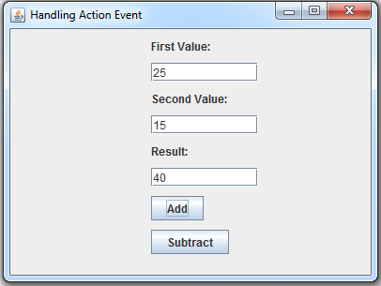
Handling Action Events
The ActionEvent is generated when button is clicked or the item of a list is double clicked.
The object that implements the ActionListener interface gets this ActionEvent when the event occurs and hence must handle the event by overriding actionPerformed() method of ActionListener interface.
Example

Slide 42
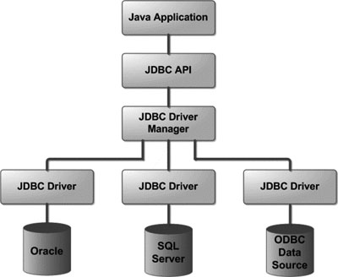
JDBC Basics
What is JDBC?
JDBC stands for Java Database Connectivity, which is a standard Java API for database-independent connectivity between the Java programming language and a wide range of databases.
JDBC Architecture

Slide 43
JDBC Basics
Common JDBC Components
The JDBC API provides the following interfaces and classes:
Driver Manager
Driver
Connection
Statement
ResultSet
SQLException

Slide 44
JDBC Driver Types
JDBC Driver Types
Type 1: JDBC-ODBC bridge driver
The JDBC-ODBC bridge driver converts JDBC method calls into the ODBC function calls.
Type 2: Native-API driver
The driver converts JDBC method calls into native c/c++ calls of the database API, which are unique to the database.
Type 3: Network Protocol driver
The Network Protocol driver uses middleware (application server) that converts JDBC calls directly or indirectly into the vendor-specific database protocol.

Slide 45
JDBC Driver Types
JDBC Driver Types
Type 4: Thin driver
The thin driver converts JDBC calls directly into the vendor-specific database protocol. That is why it is known as thin driver.

Slide 46
JDBC Driver
The JDBC driver is a file with the extension .jar (some drivers need more than one file). Here is an overview of common JDBC drivers, and the class name that need to be used.
Oracle
Class name-oracle.jdbc.OracleDriver
Jar file-ojdbc6.jar, ojdbc7.jar
Mysql
Class name- com.mysql.jdbc.Driver
Jar file-mysql-connector-java-5.1.5-bin.jar (exact name depends on version)
SQL Server
class file- com.microsoft.sqlserver.jdbc.SQLServerDriver
Jar file-sqljdbc4.jar

Slide 47
JDBC Steps
Register the driver class: The forName() method of Class class is used to register the driver class. This method is used to dynamically load the driver class.
Creating connection: The getConnection() method of DriverManager class is used to establish connection with the database.
Creating statement: The createStatement() method of Connection interface is used to create statement. The object of statement is responsible to execute queries with the database.
Executing queries: Once we have created a Statement object, we can use it to execute a SQL statement with one of its three execute methods.

Slide 48
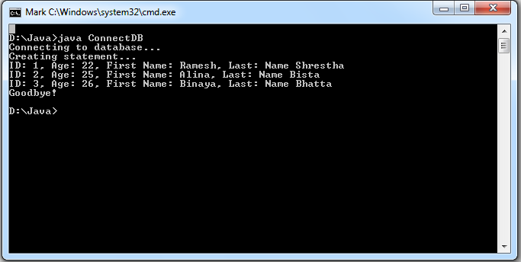
JDBC Steps
Closing connection: By closing connection object statement and ResultSet will be closed automatically. The close() method of Connection interface is used to close the connection.
Example

